Slide 1
Vehicle Detection from Color Images
Militaru Cristian
Gr. 30431

Slide 2
Problem statement
Given:
A color video (sequence of images)
Find:
The vehicles in each moment

Slide 3
Input

Slide 4
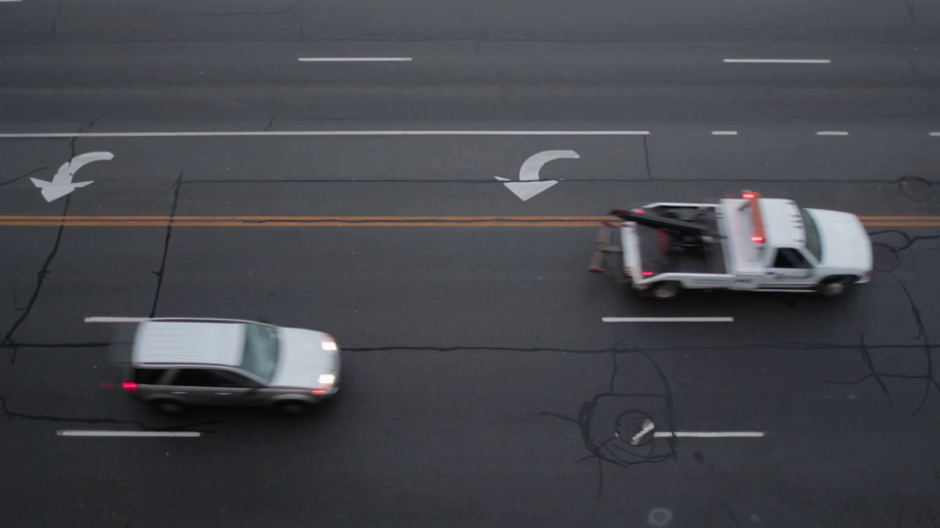

Slide 5
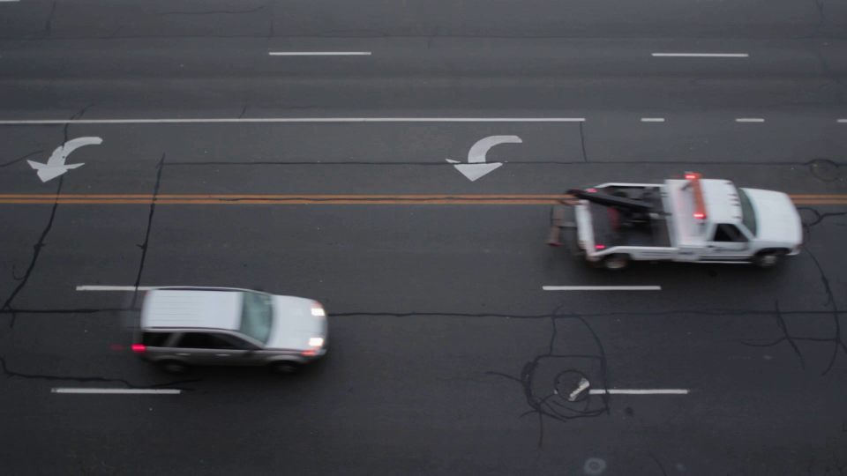

Slide 6
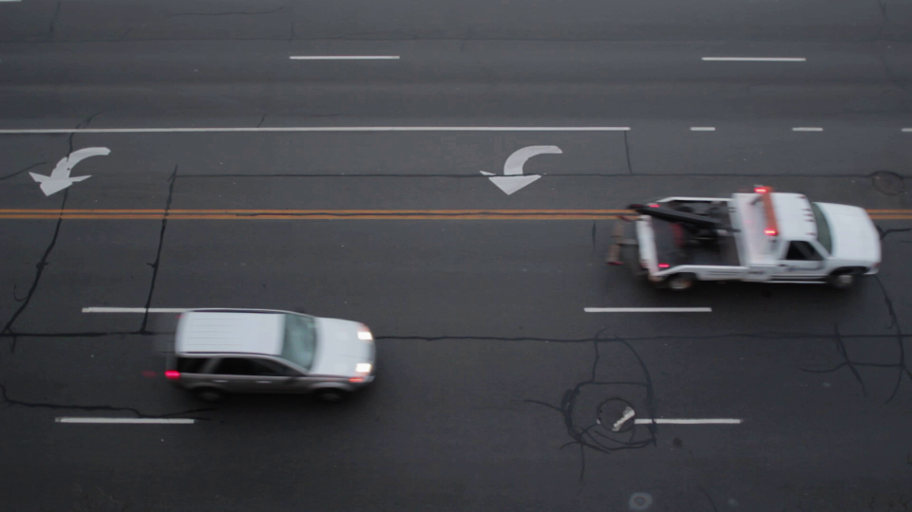

Slide 7
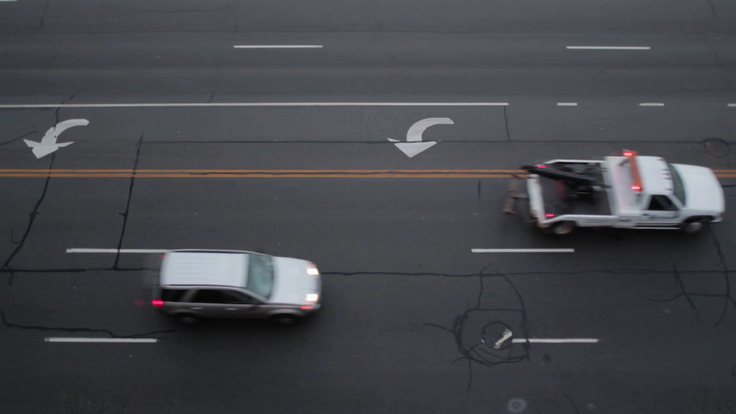

Slide 8
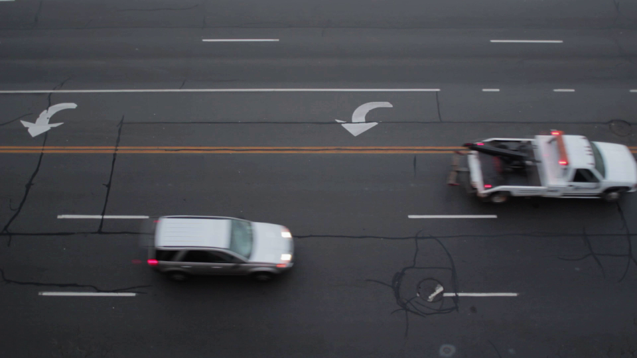

Slide 9
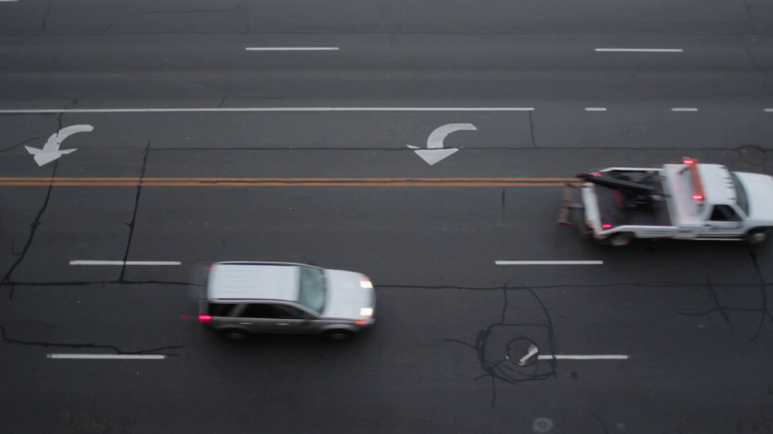

Slide 10
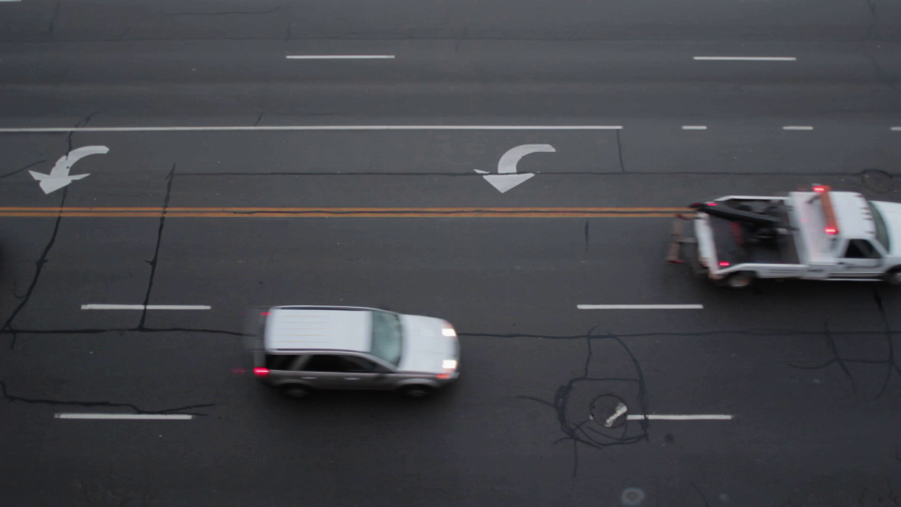

Slide 11
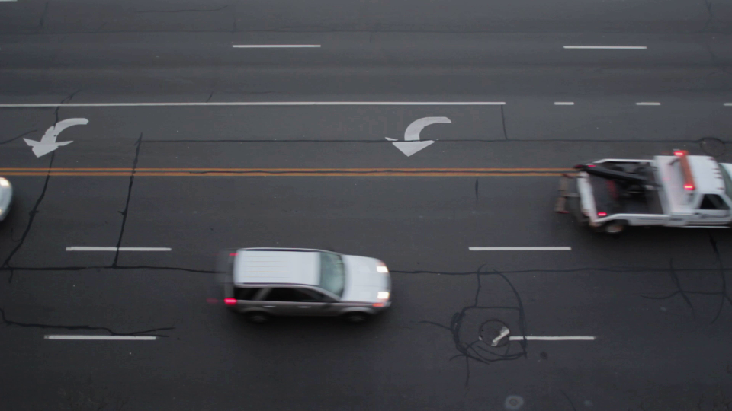

Slide 12
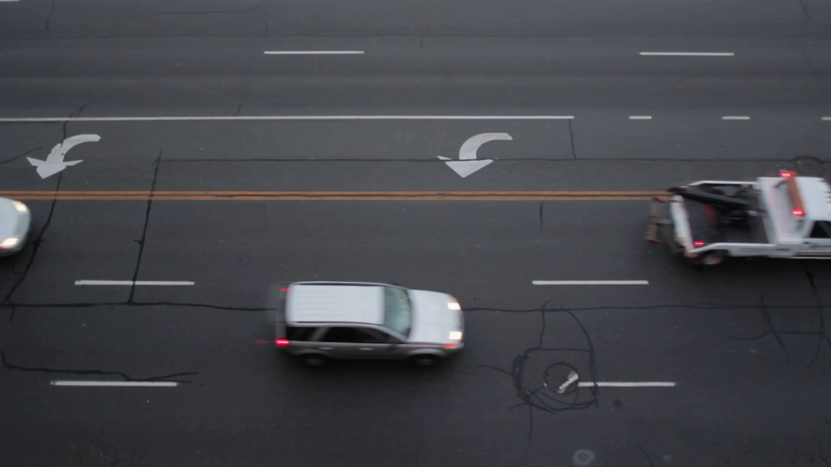

Slide 13
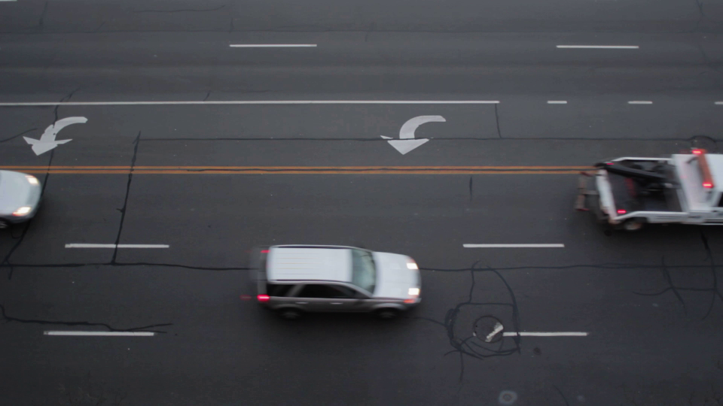

Slide 14
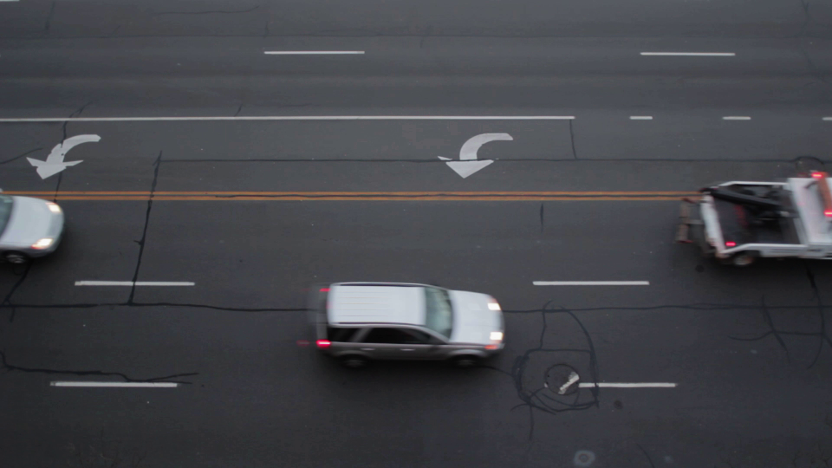

Slide 15
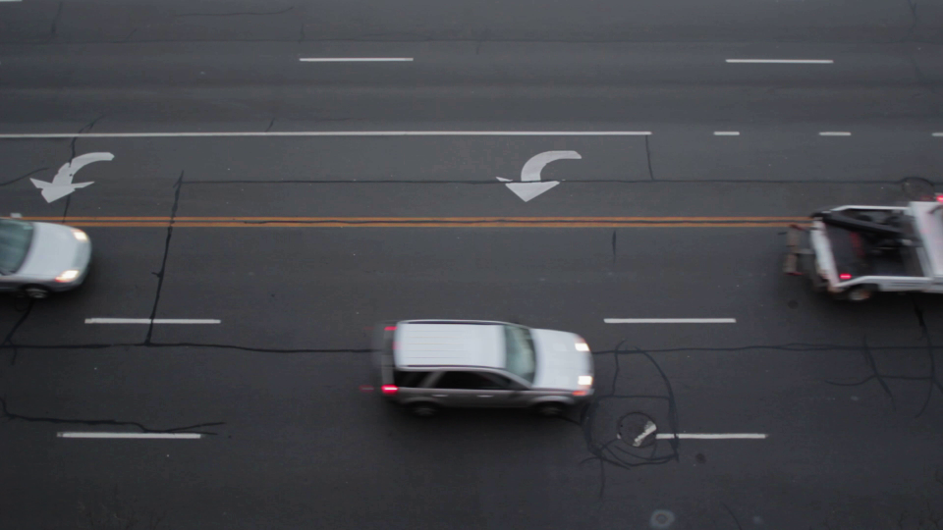

Slide 16
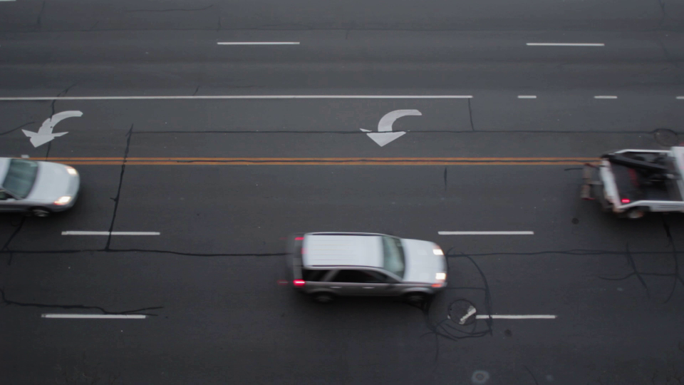

Slide 17
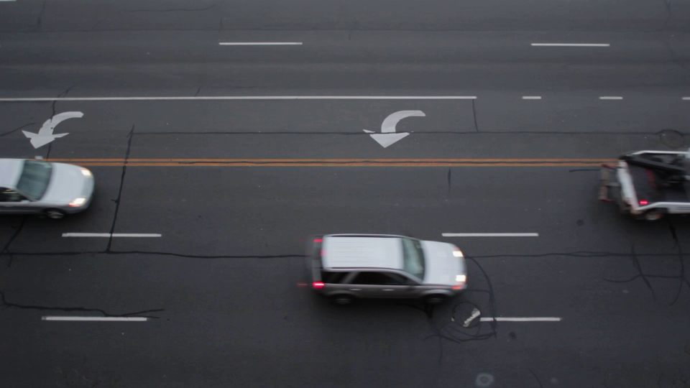

Slide 18
Output

Slide 19
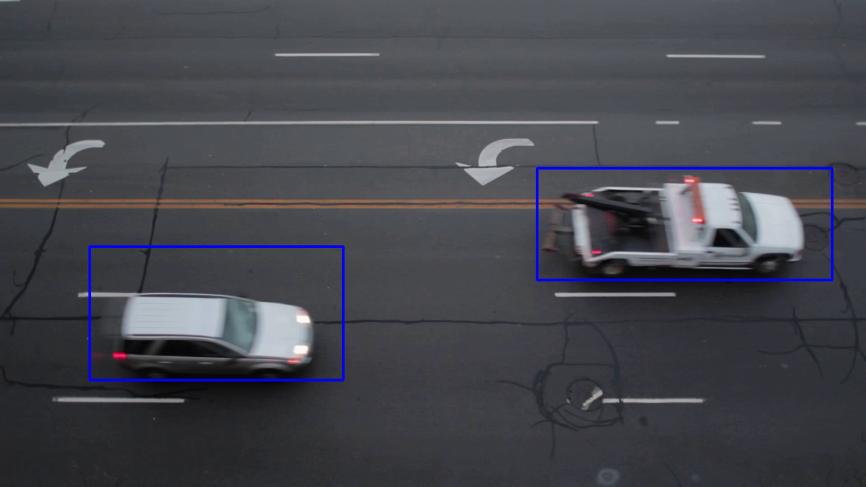

Slide 20
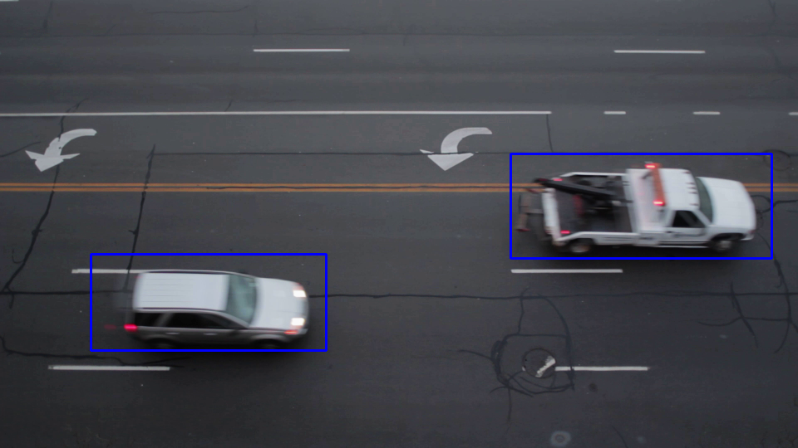

Slide 21
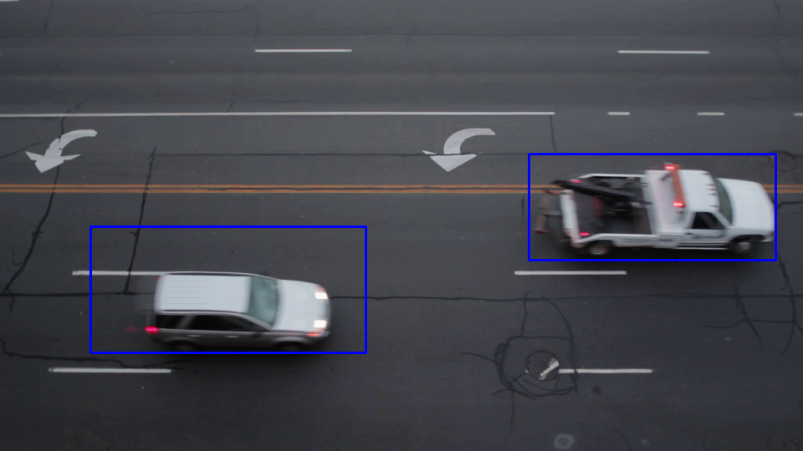

Slide 22
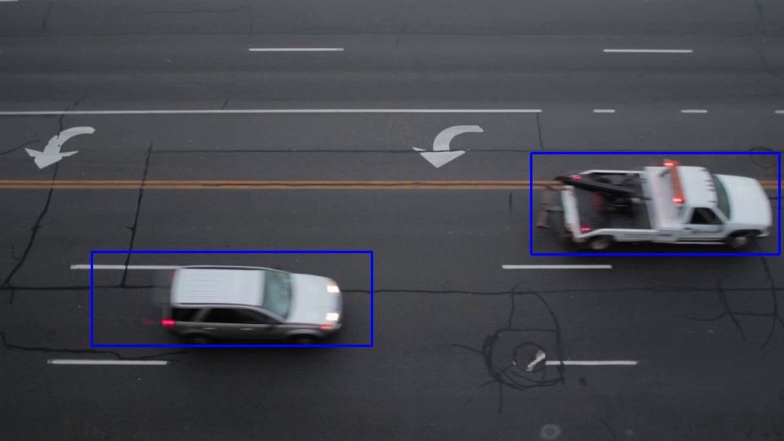

Slide 23
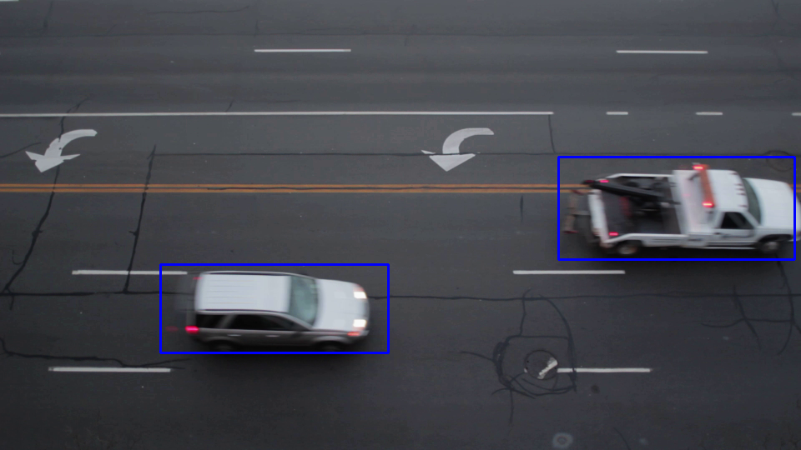

Slide 24
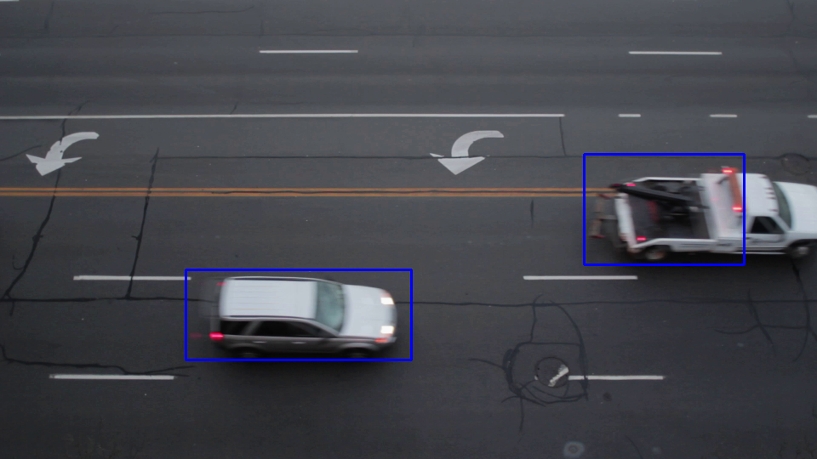

Slide 25
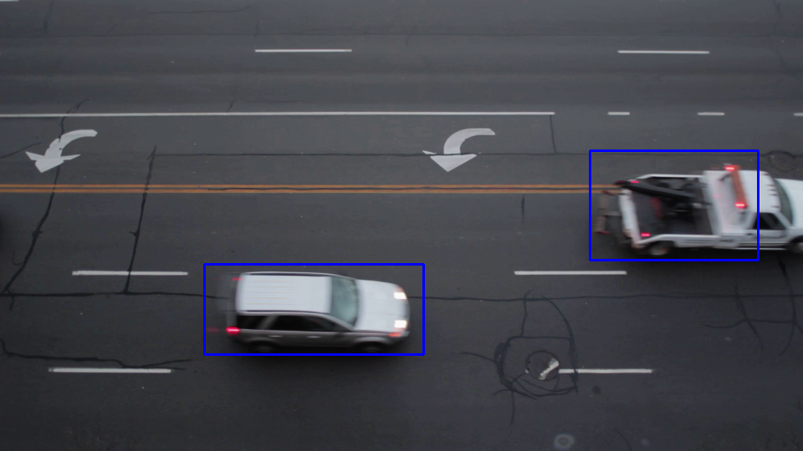

Slide 26
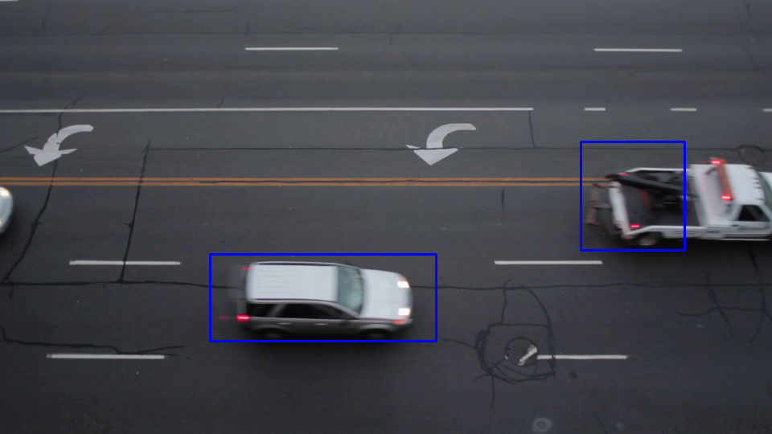

Slide 27
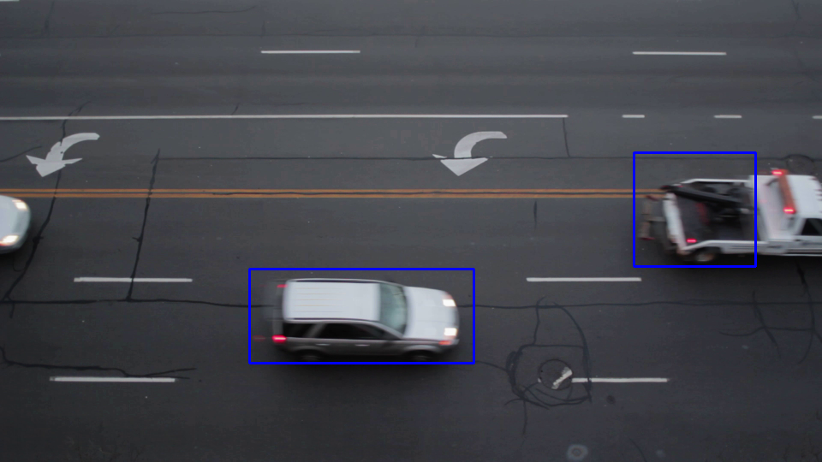

Slide 28
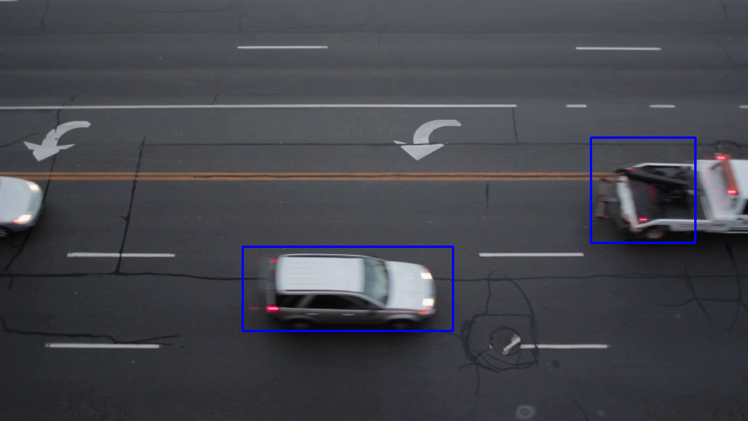

Slide 29
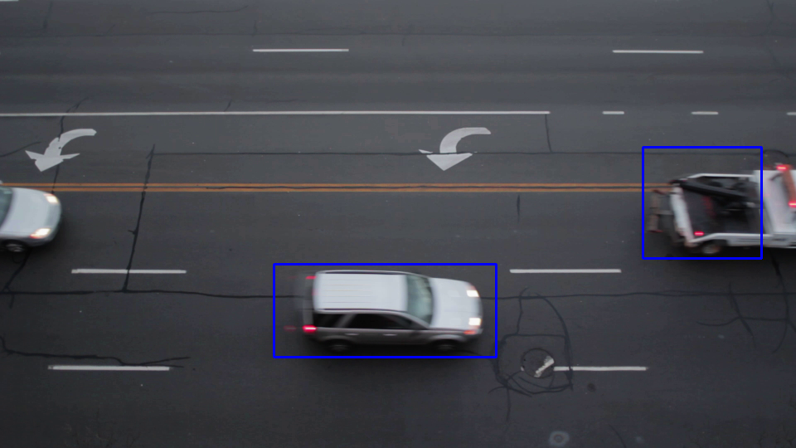

Slide 30
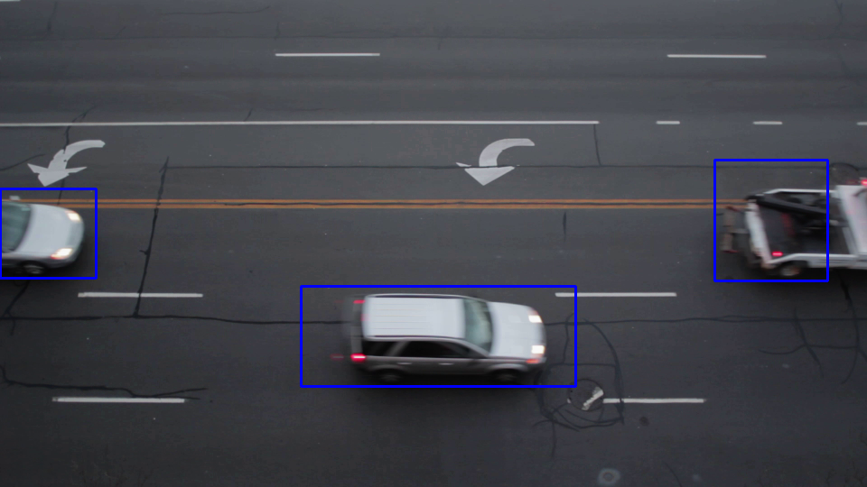

Slide 31
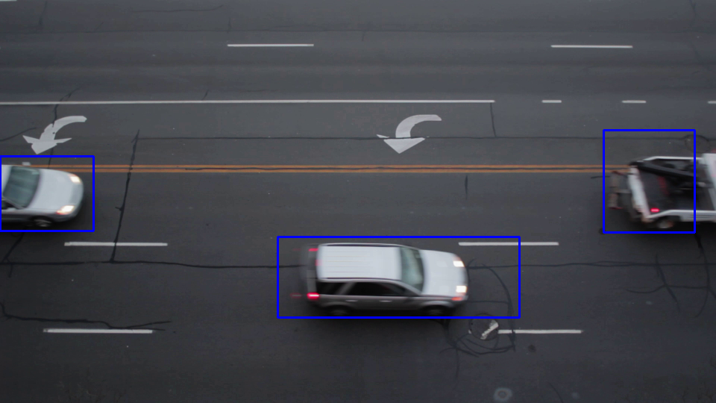

Slide 32
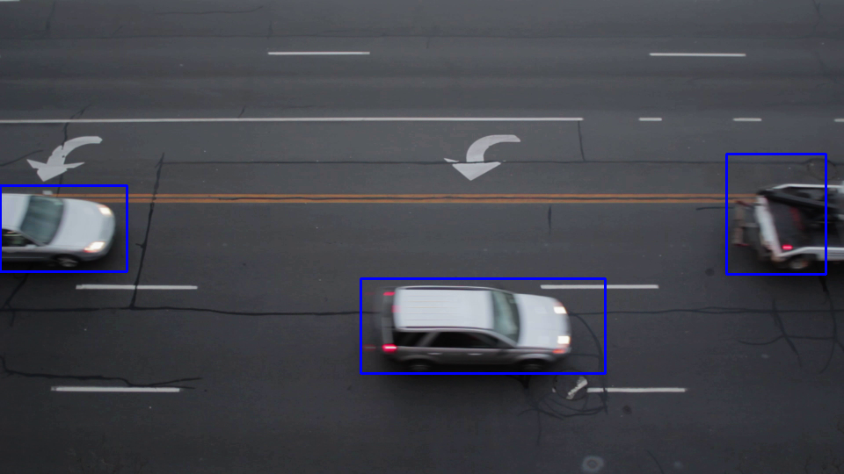

Slide 33
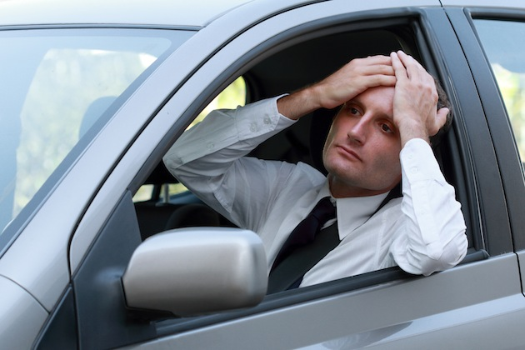
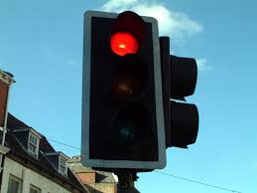
Application
Vehicle counter
Minimize traffic light waiting time

Slide 34
How?
Optical flow
We need 2 consecutive frames.

Slide 35
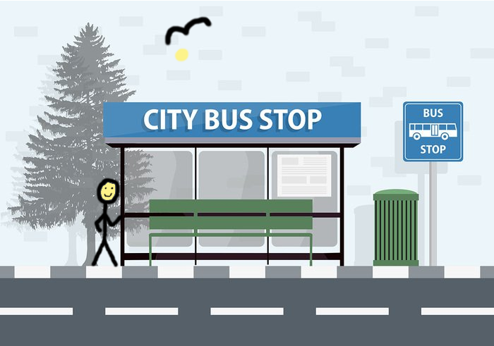
How?
Optical flow
Image #1

Slide 36
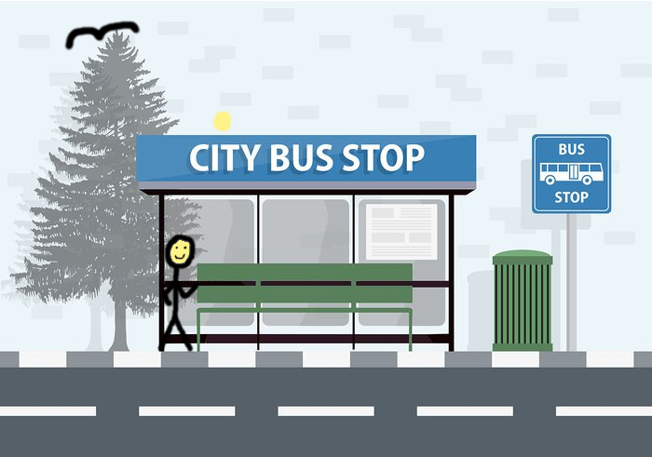
How?
Optical flow
Image #2

Slide 37
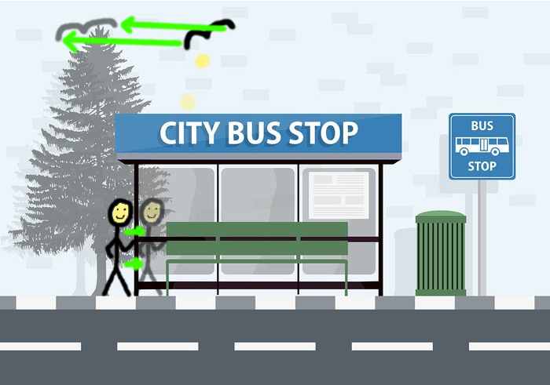
How?
Optical flow
Optical Flow

Slide 38

How?
Optical flow
Optical Flow
Magnitude
(black = no movement,
white = big movement)

Slide 39
In real world
Image #1

Slide 40
In real world
Image #2

Slide 41
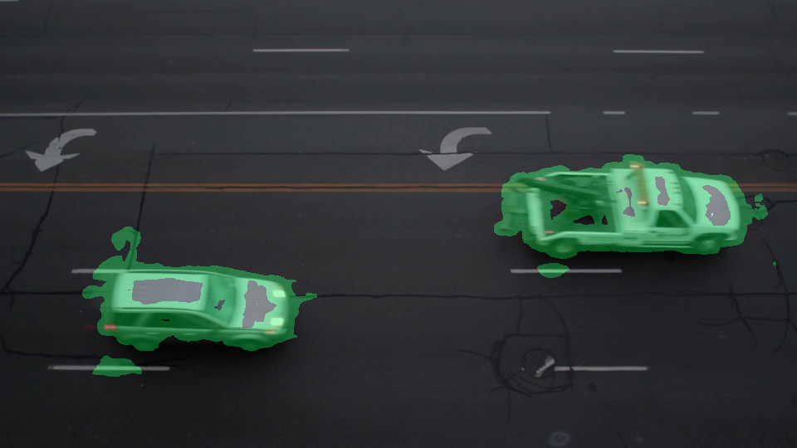
In real world
Big optical flow was highlighted with green

Slide 42
In real world
+ Clustering and filtering

Slide 43
Problems
Noise
Remove the moving areas that are too small

Slide 44


